Slide 1

Machine Learning Strategies for Strengthened Phishing URL Detection
Presented By:
Ch. Akshay Reddy
22STUCHH010751

Slide 2
Contents
Introduction
Existing System
Dis-advantages of Existing System
Proposed System
Block Diagram
Implementation
Methodology
Advantages of Proposed System
Conclusion
References

Slide 3
INTRODUCTION
Phishing websites are fake websites that look like real ones.
They try to trick you into giving your personal information, like your username, password, or bank details.
Hackers use these fake sites by copying the look and web address of trusted websites to fool people into clicking on them.
To fight against phishing , machine learning, specifically the Gradient Boosting Classifier, is used to analyze URL features and detect fraudulent sites.
This method effectively differentiates phishing websites from genuine ones in real time.

Slide 4
EXISTING SYSTEM
S.no | Authors | Focus Area | Key Findings
1 | Andrew Jones, Mahmoud Khonji, Youssef Iraqi [1] | Phishing Mitigation | Surveys phishing mitigation techniques, categorizing them into detection, offensive defense, correction, and prevention. No single solution effectively mitigates all phishing vulnerabilities.
2 | Alessandro Acquisti, Idris Adjerid, Rebecca Balebako, Laura Brandimarte, Lorrie Faith Cranor, Saranga Komanduri ,Pedro Giovanni Leon, Norman Sadeh, Florian Schaub [2] | Privacy and Security Decision-Making | Analyzes how soft paternalistic interventions (nudges) assist users in making better privacy and security choices, while discussing ethical and design challenges.
3 | F.J. Overink, M. Junger, L. Montoya [3] | Social Engineering | Investigates the effectiveness of priming and warnings in preventing social engineering attacks. Found that neither intervention significantly influenced disclosure behavior, with possible adverse effects.

Slide 5
EXISTING SYSTEM
4 | M. El-Alfy, El-Sayed M [4] | Phishing Detection | Proposes a phishing detection model using Probabilistic Neural Networks (PNN) and K-Medoids clustering. Achieves >97% accuracy with >40% complexity reduction.
5 | Shuang Hao, Luca Invernizzi, Yong Fang, Christopher Kruegel, Giovanni Vigna [5] | Botnet Detection | Develops a methodology to detect algorithmically generated domain names used by botnets (e.g., Conficker). Uses multiple distance metrics and achieves minimal false positives.
6 | Ammara Zamir et al. [6] | Phishing Detection | Evaluates multiple machine learning models for phishing detection, comparing their accuracy and performance. Highlights the effectiveness of ensemble techniques.
7 | Lizhen Tang & Qusay H. Mahmoud [7] | Phishing Detection | Provides an overview of machine learning techniques used for phishing website detection. Discusses challenges and future research directions.

Slide 6
EXISTING SYSTEM
These and most of the existing systems have used these algorithms:
1. Logistic regression
2. Multinomial Naives Bayes
3. XGBoost.

Slide 7
DISADVANTAGES OF EXISTING SYSTEM
Existing system model:
1. Do not have any specific user-interface.
2. Fails to predict continuous outcome.
3. May not be accurate, if sample size is too small.
4. Low latency.
5. These may lead to overfitting problem.

Slide 8
PROPOSED SYSTEM
Developed project using a website as a platform for all users.
This is an interactive and responsive website that will be used to detect whether a website is safe or un-safe.
This website is made using different web designing languages which include HTML, CSS, JavaScript and Flask framework in Python.
Basic structure of the website is made with the help of HTML.
CSS is used to add effects to the website and make it more attractive and user-friendly.

Slide 9
PROPOSED SYSTEM
CSS is used to add effects to the website and make it more attractive and user-friendly.
It must be noted that the website is created for all users, hence it must be easy to operate.
After the system is trained with the dataset, it prompts the user that the website is safe or un-safe.
We have detected phishing websites using Gradient Boosting Classifier with and accuracy of 97%.

Slide 10
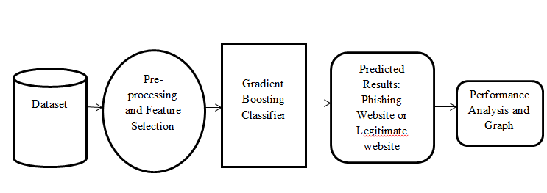
SYSTEM ARCHITECTURE

Slide 11
Implementation
Data Collection – Obtaining data from Kaggle.
Dataset Description – Features and attributes used.
Data Preparation – Cleaning, preprocessing, and splitting data.
Model Selection – Using Gradient Boosting Classifier for phishing detection.
Training & Analysis – Optimizing the model using boosting techniques.
Accuracy & Testing – Measuring model performance.

Slide 12
Methodology
Machine Learning Framework – Using Gradient Boosting for classification.
Evaluation Metrics – Accuracy, loss function, and performance tuning.
Training Strategy – Sequential learning to minimize errors iteratively.
Feature Engineering – Selecting relevant attributes from URLs.

Slide 13
ADVANTAGES OF PROPOSED SYSTEM
User Interface is provided
Model is trained using many features
High level of accuracy
The proposed system is generally more accurate compare to other modes.

Slide 14
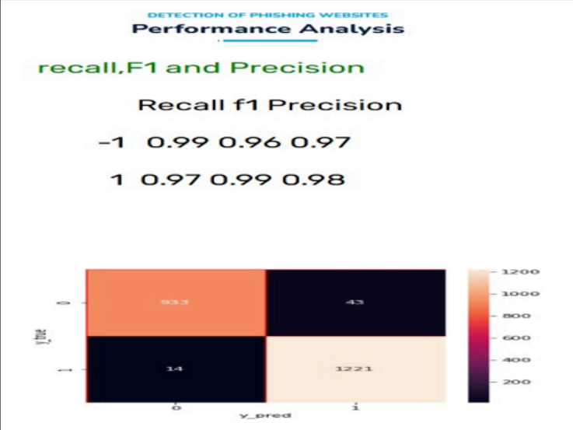
RESULTS

Slide 15
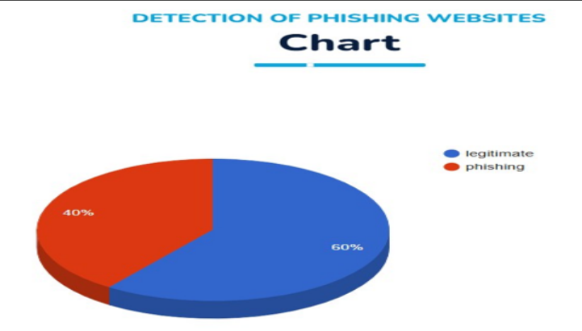
RESULTS

Slide 16
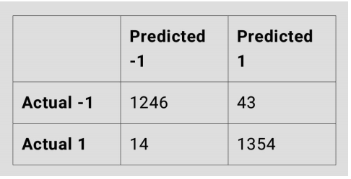
RESULTS
The Gradient Boosting Classifier helped us achieve high accuracy (97%) in
detection.

Slide 17
Conclusion
In this project, we used machine learning to detect fake or
phishing websites.
We built a user-friendly website that warns users about unsafe
URLs.
The Gradient Boosting Classifier helped us achieve high
accuracy (97%) in detection.
This system works in real time and is better than older methods.
It helps people stay safe online by spotting harmful websites
quickly.

Slide 18
MAJOR REFERENCES
[1] Ammara Zamir et al. - Phishing Website Detection Using Diverse Machine Learning Algorithms (2020).
[2] Lizhen Tang & Qusay H. Mahmoud - A Survey of Machine Learning-Based Solutions for Phishing Website Detection (2021).
[3] A. Karim et al. - Phishing Detection System Through Hybrid Machine Learning Based on URL (IEEE Access, 2023).
[4] Faisal S. Alsubaei et al. -Enhancing Phishing Detection: A Novel Hybrid Deep Learning Framework for Cybercrime Forensics* (IEEE, 2024).
[5] S. Remya et al. - An Effective Detection Approach for Phishing URL Using ResMLP (IEEE, 2024).
[6] Ahmad Sahban Rafsanjani et al. - *Enhancing Malicious URL Detection: A Novel Framework Leveraging Priority Coefficient and Feature Evaluation*
[7] Valentine Adeyemi Onih - Phishing Detection Using Machine Learning: A Model Development and Integration.
[8] JianTing Yuan et al. - A Novel Approach for Malicious URL Detection Based on the Joint Model (2021).
[9] Haya T. Alhuraib et al. - Detecting Malicious URLs Using Machine Learning Techniques: Review and Research (IEEE, 2022).
[10] Malak Aljabri et al. - Detection of Phishing Websites Using Machine Learning (ICCCI, 2022).

